Slide 1
Figures – Exp1

Slide 2
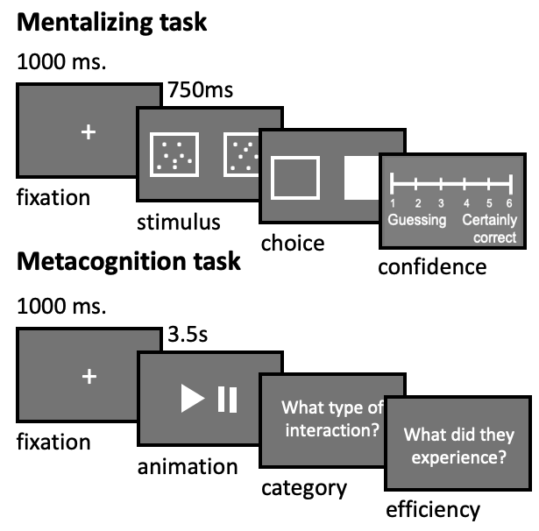
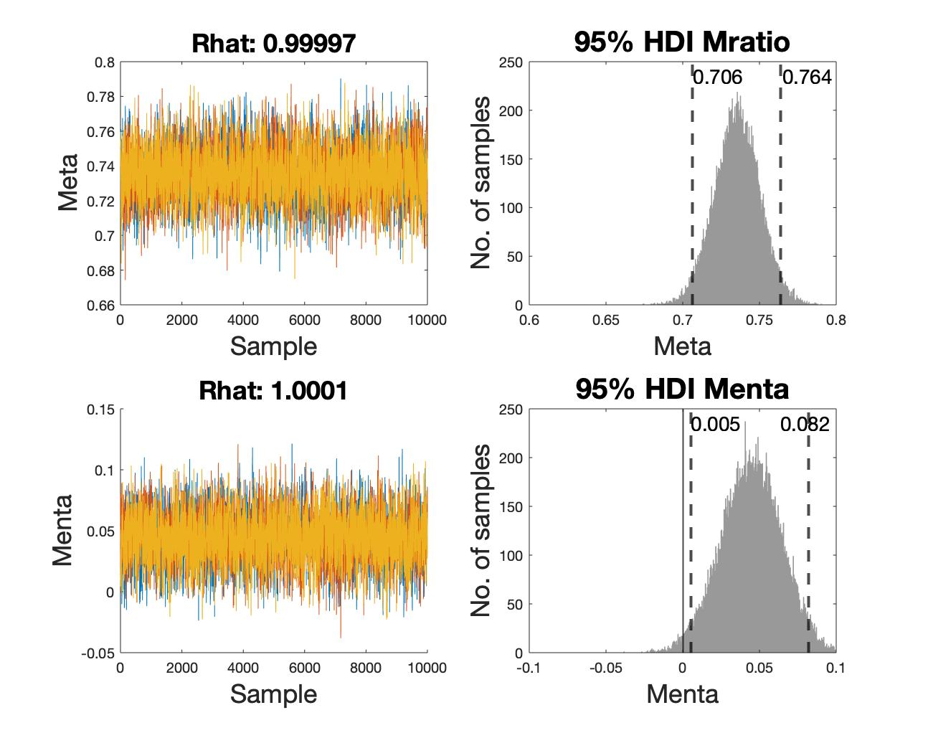
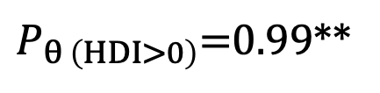
Fig1 – Methods + MetaMenta
a. c.
b.
N=477
$P_{θ \left(HDI>0\right)}$=0.99**
Mentalising efficiency

Slide 3
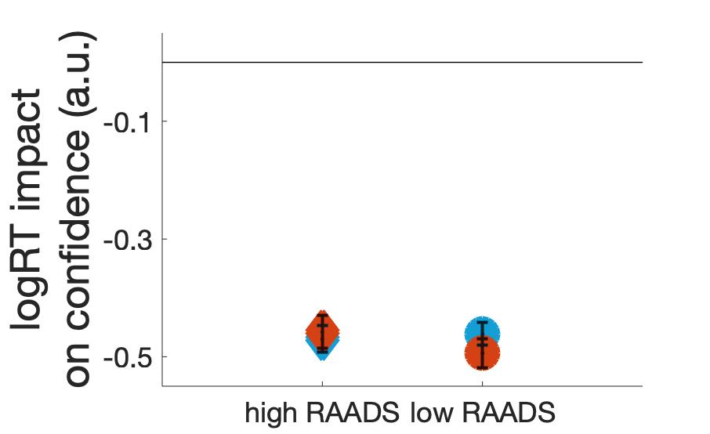
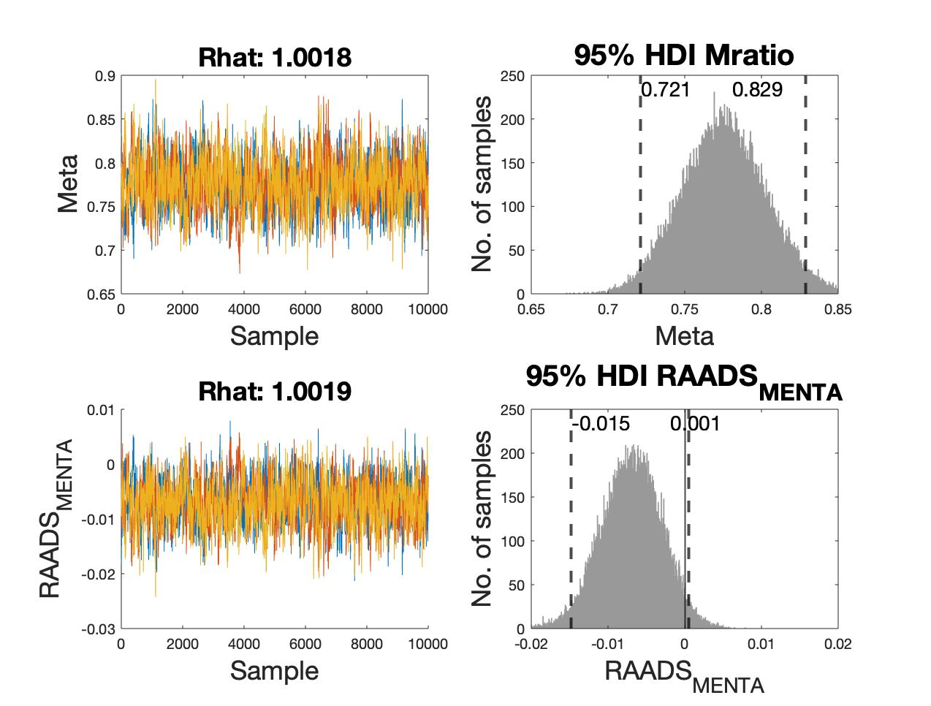

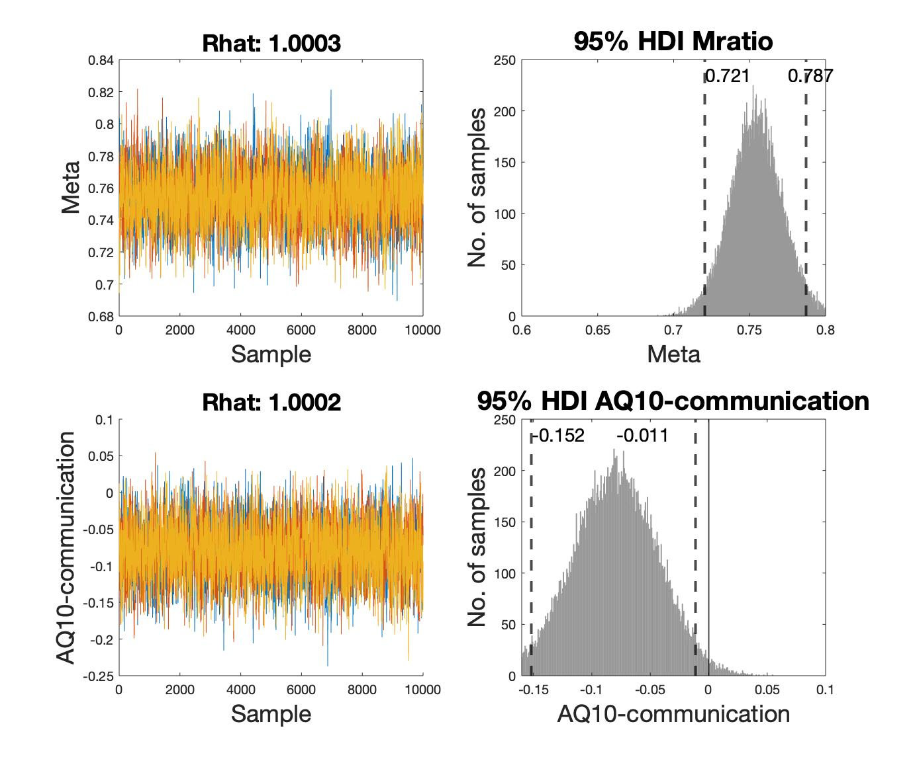
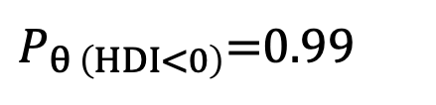
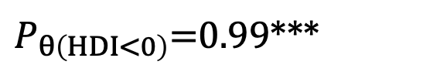
Fig 2 – AQ communication + RT
a. b. c.
0
95% HDI AQ-10_{communication}
95% HDI RAADS-14_{mentalizing}
*
$P_{θ\left(HDI<0\right)}$=0.99***
$P_{θ \left(HDI<0\right)}$=0.99
AQ-10_{communication}
RAADS-14_{mentalizing}

Slide 4
Figures – Exp2

Slide 5
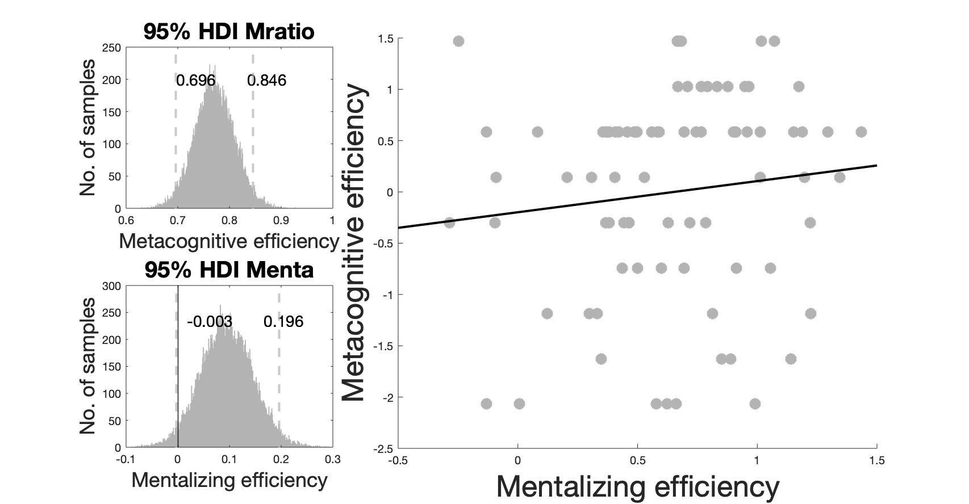
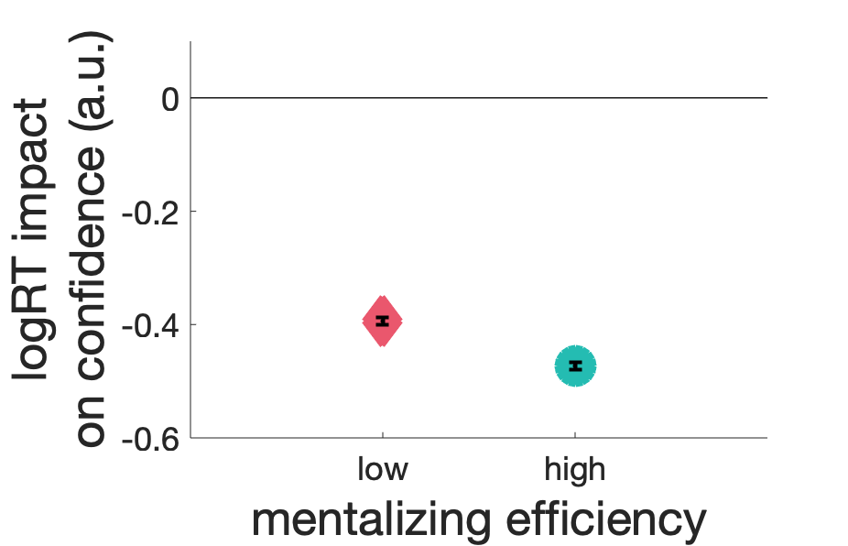
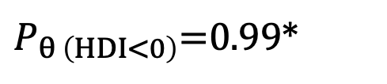
a. c.
b.
Mentalizing
efficiency
$P_{θ \left(HDI<0\right)}$=0.99*
**
N=80

Slide 6
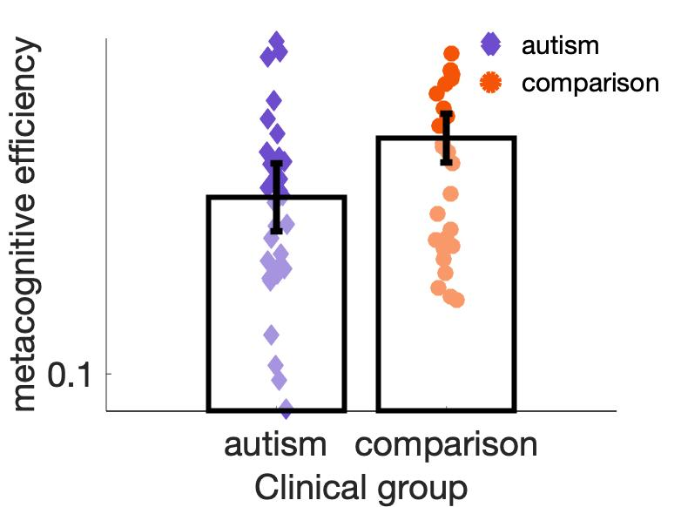
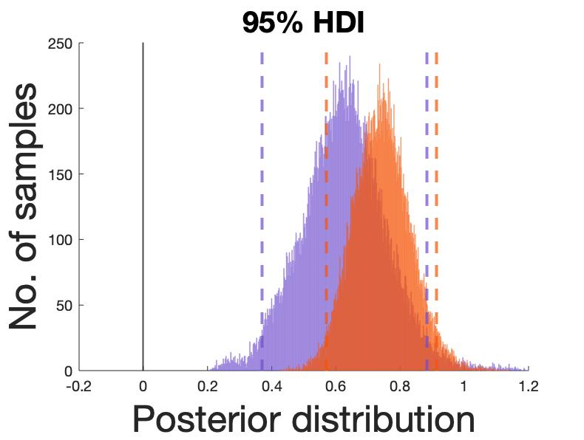
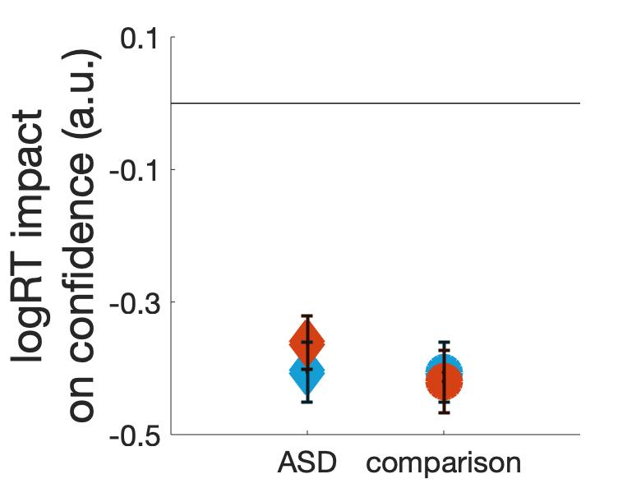
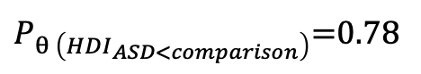
a. b. c.
**
$P_{θ \left({HDI}_{ASD<comparison}\right)}$=0.78
correct
error
P = 0.079

Slide 7
Supplementary Figures – Exp1

Slide 8
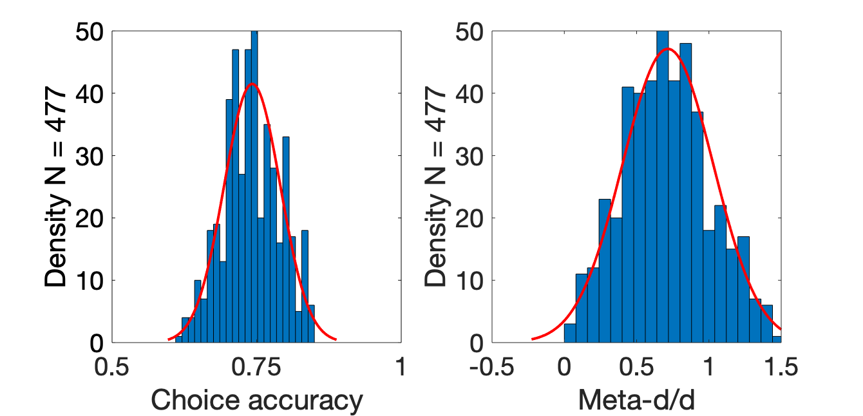
a. b. c.
logRT

Slide 9
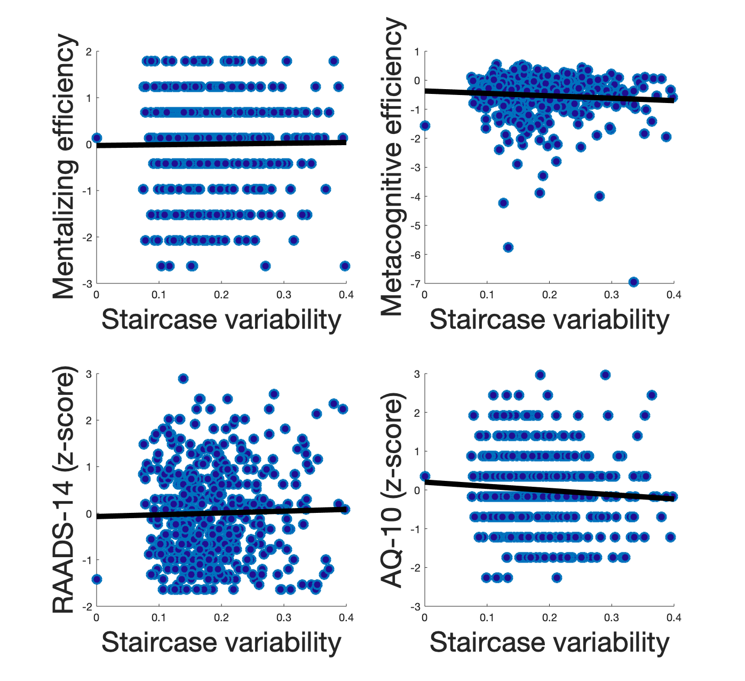
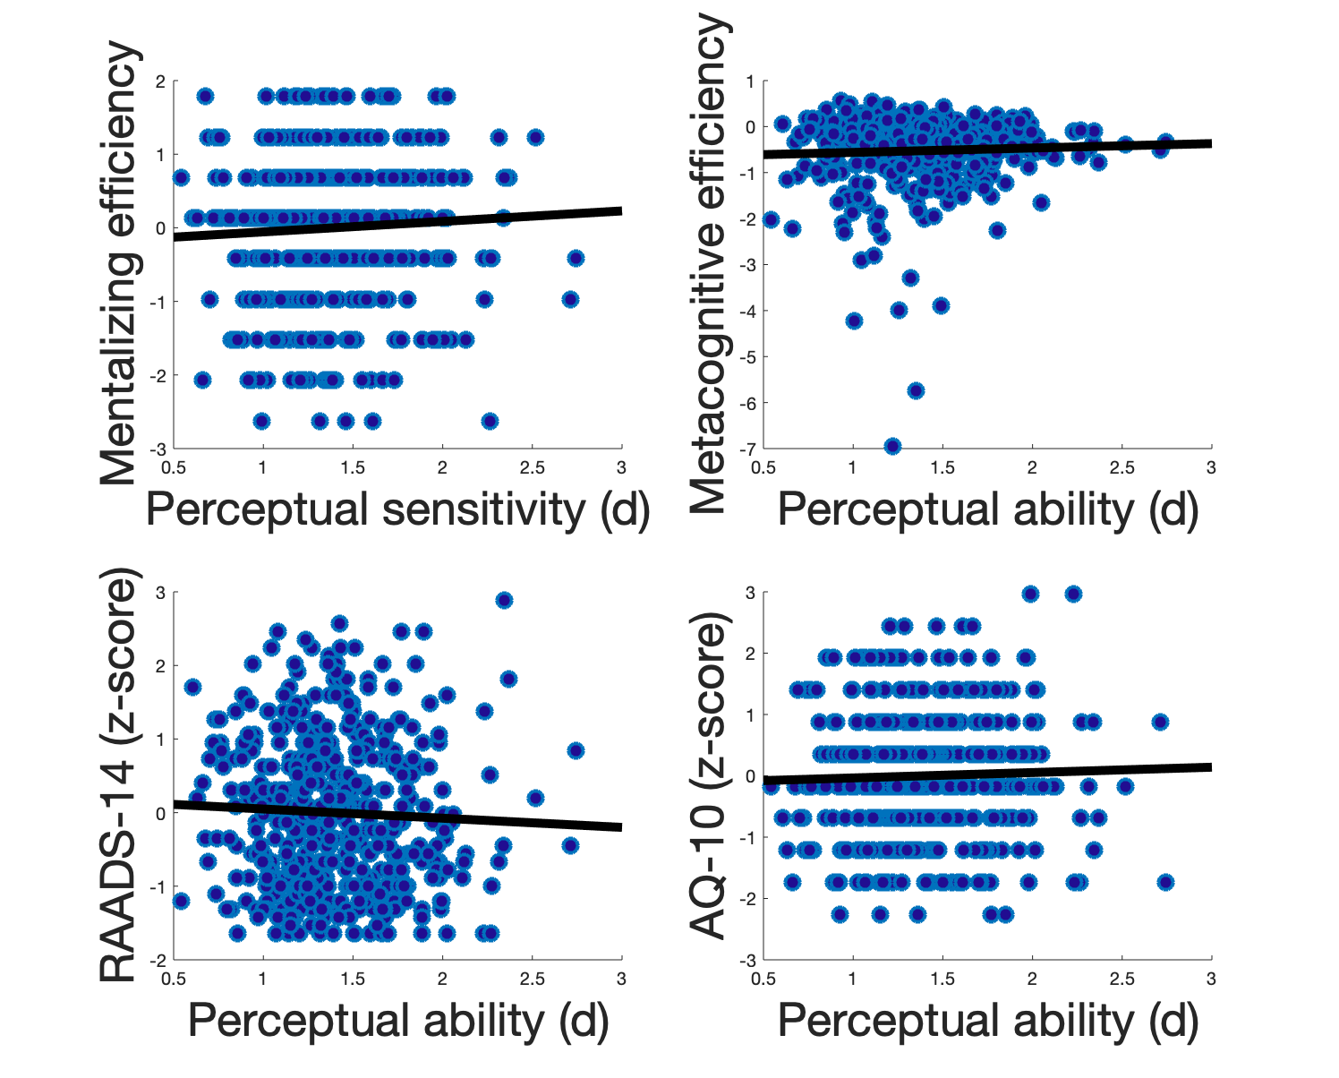
a. b.
c. d.
e. f.
g. h.

Slide 10
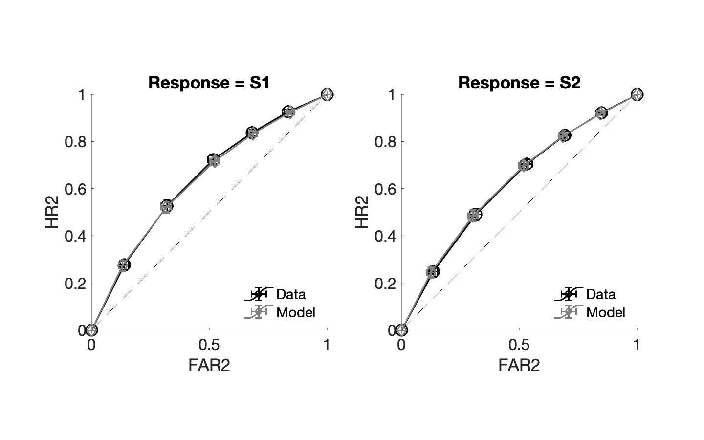
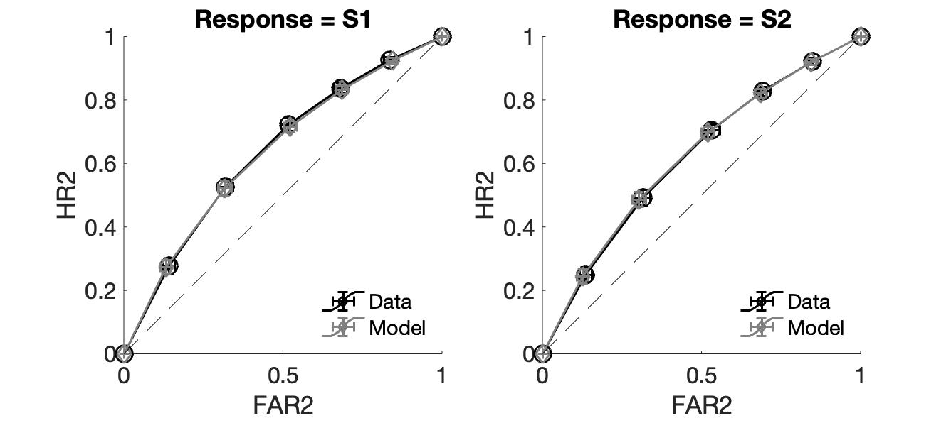
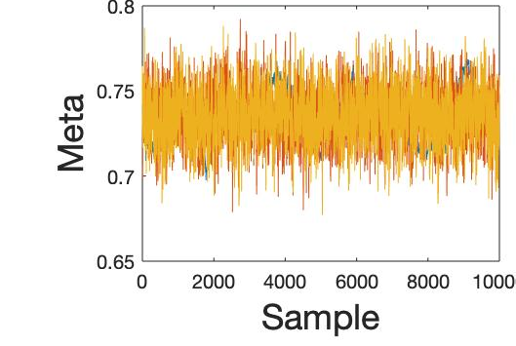

a. b.
c. d.
e. f.

Slide 11
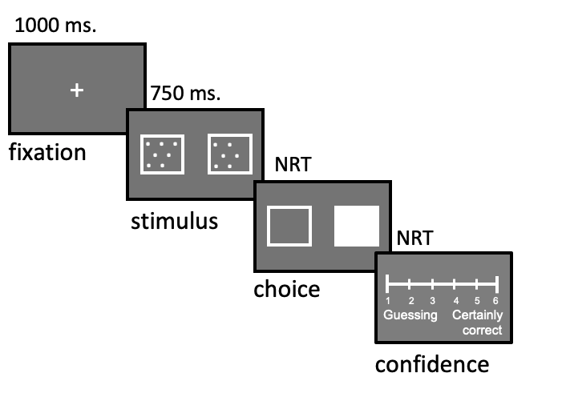
Mentalizing task
1000 ms.
+
750ms
. .
. .
. .
. .
. .
. .
. .
. .
fixation
stimulus
Metacognition task
choice
confidence
1000 ms.
+
3.5s
What type of interaction?
fixation
What did they experience?
animation
category
efficiency

Slide 12
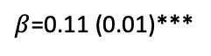
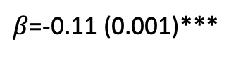
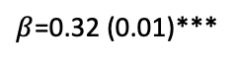
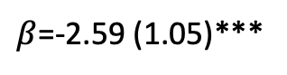
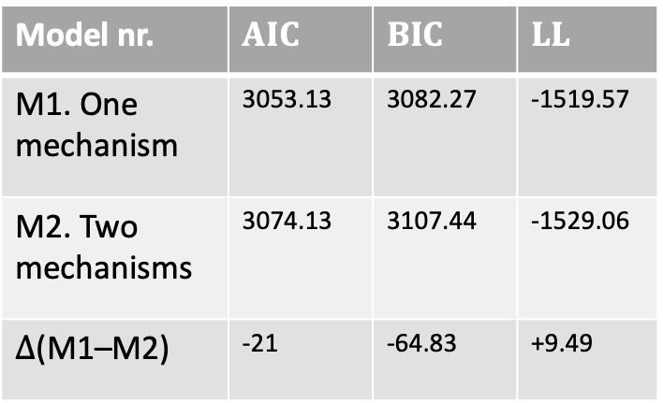
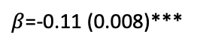
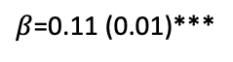
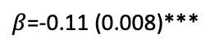
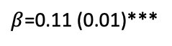
Fig 3 - SEM
a. b.
autistic traits
$β$=-2.59 (1.05)***
higher order cognition
Model nr. | $$AIC$$ | $$BIC$$ | $$LL$$
M1. One mechanism | 3053.13 | 3082.27 | -1519.57
M2. Two mechanisms | 3074.13 | 3107.44 | -1529.06
$∆$(M1–M2) | -21 | -64.83 | +9.49
$β$=0.11 (0.01)***
$β$=0.11 (0.01)***
$β$=-0.11 (0.008)***
$β$=-0.11 (0.008)***
meta
menta
AQ10
RAADS
$β$=0.32 (0.01)***
$β$=0.11 (0.01)***
$β$=0.11 (0.01)***
$β$=-0.11 (0.001)***
meta
menta cat.
menta emo.

Slide 13
Supplementary Figures – Exp 2

Slide 14
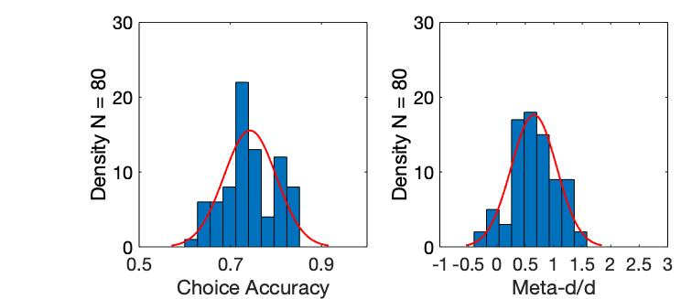
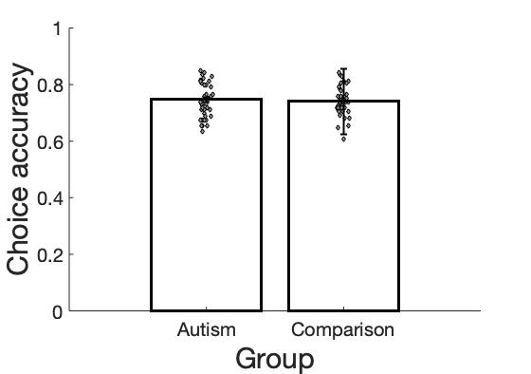
a. b.
c. d.
Density N = 80
logRT

Slide 15
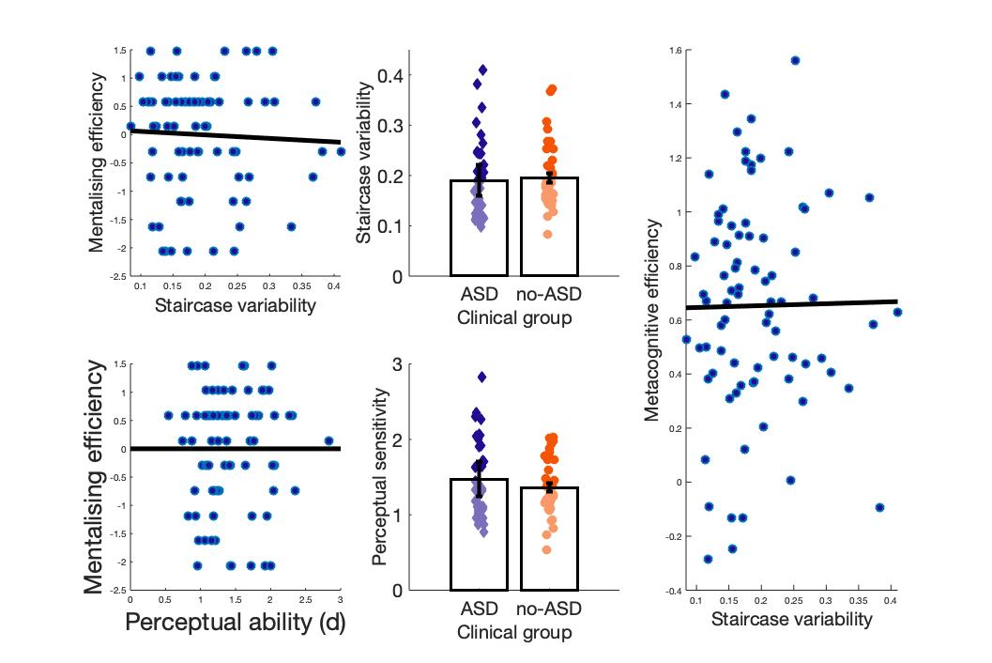
a. b. c.
d. e.

Slide 16
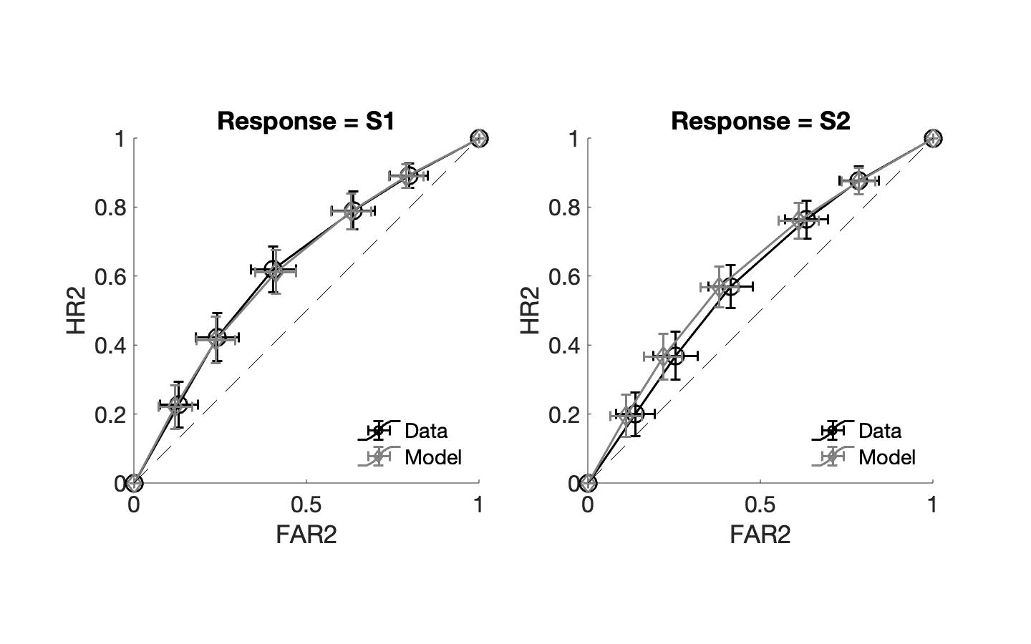
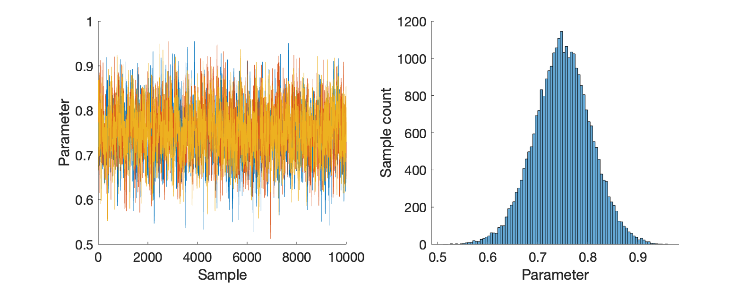
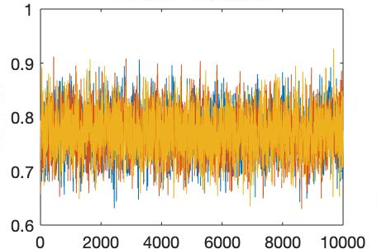
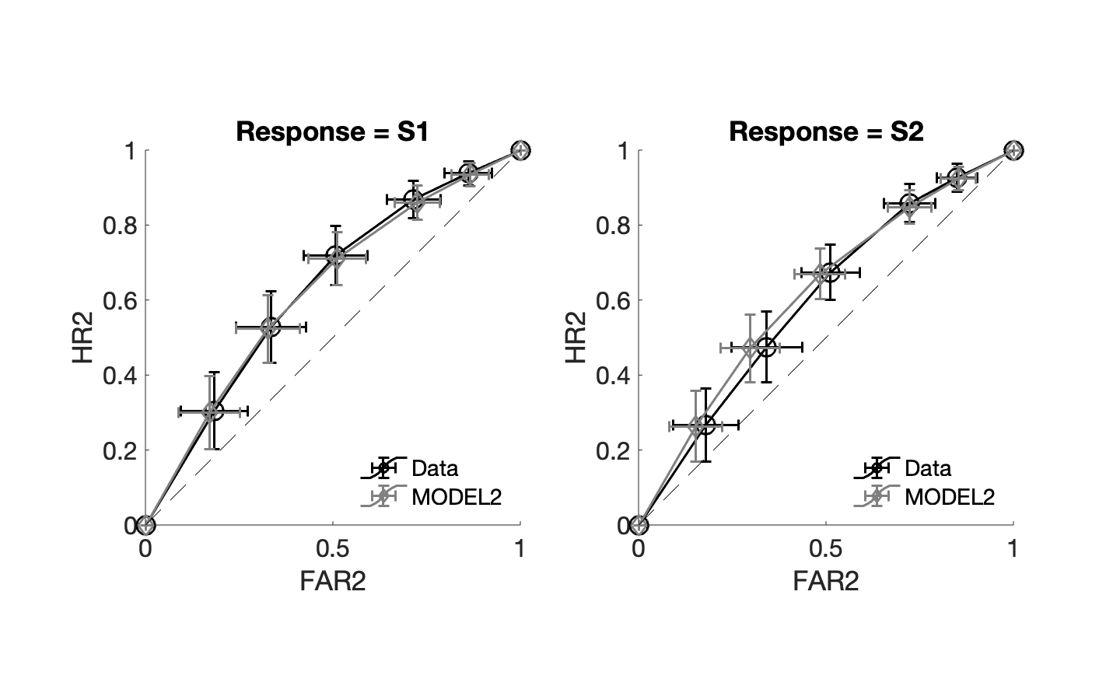
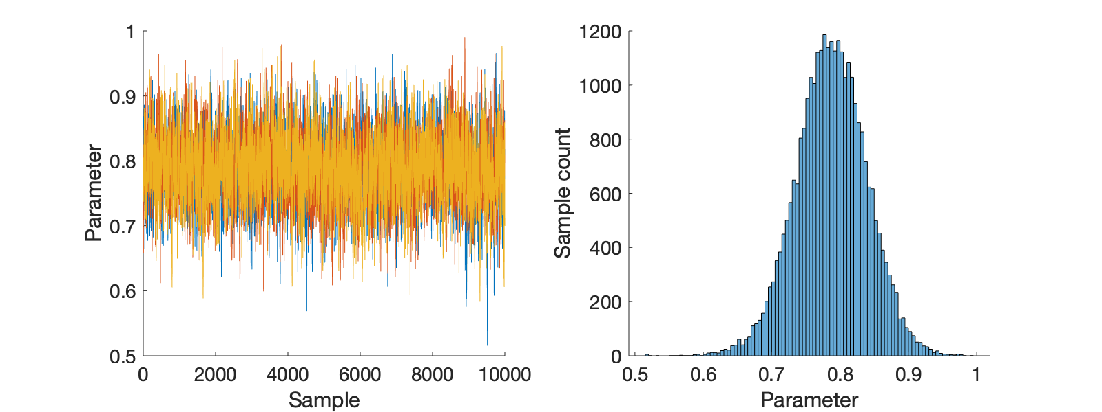
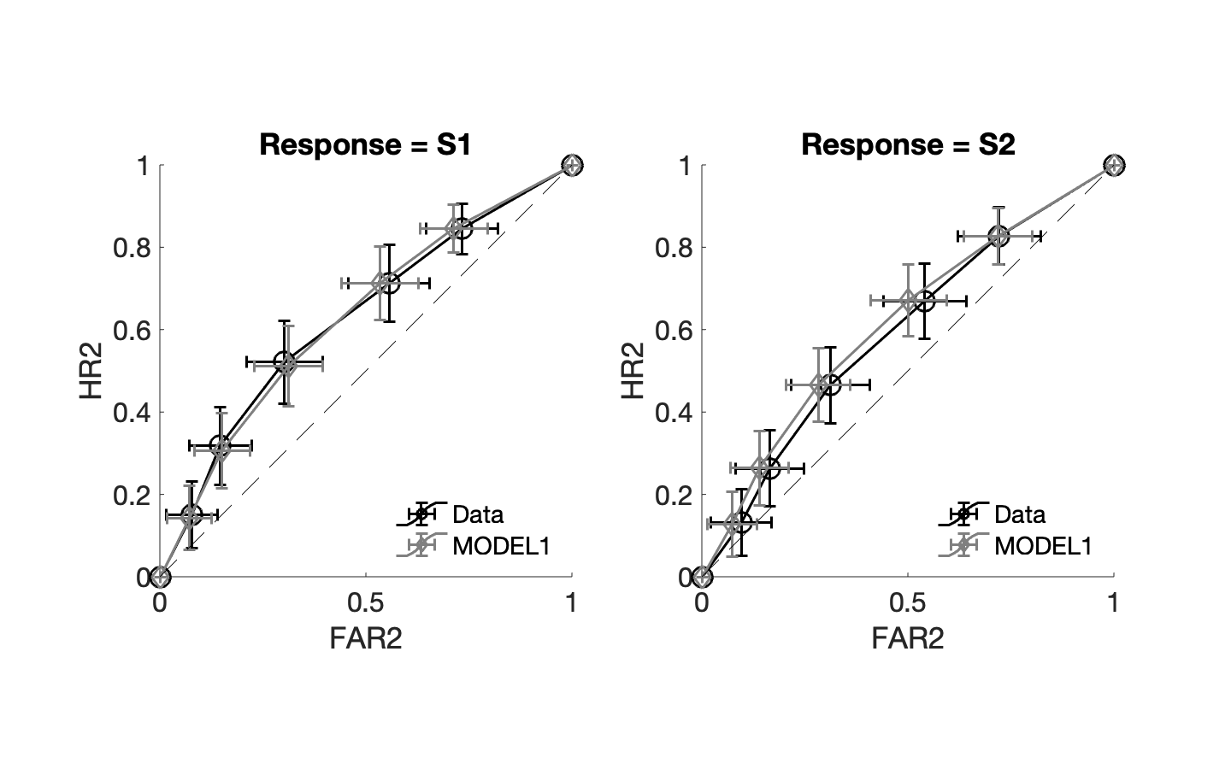
a. b.
c. d.
e. f.

